Slide 1
MultiDomain: DIGITAL IDENTITY ASSETS through domains
Enrico Fabris
Chief Technology Officer
12/04/2024

Slide 2






Acquisition is a Growth Strategy

Slide 3



Acquisition is a Growth Strategy
…could be an IT Nightmare
Users cannot access
IT workers cannot fix problem
Governance is gone
…could actually be a Business Nightmare

Slide 4

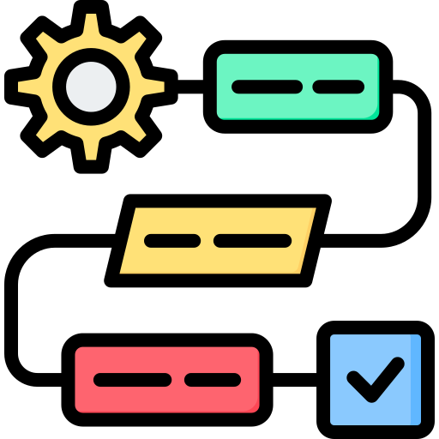
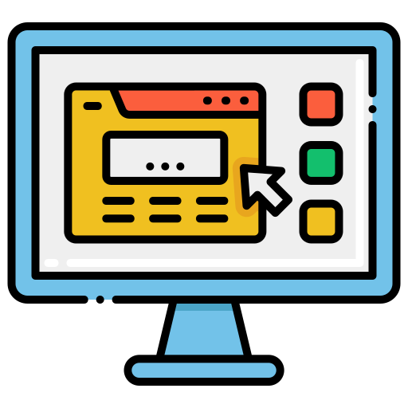

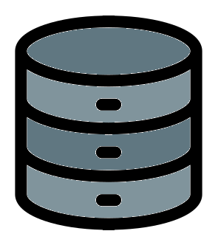



What is a domain?
Traditional idea of domain:
Fully Qualified Domain Name
Active Directory Domain
Email Domain
A domain is an isolated applicative context
ACME CO.
GLOBEX

Slide 5

What is multidomain feature?
Multidomain idea was born in 2015 to:
Allow users access
Delegate and split assets management
Segregate users' roles, privileges and profiles
Bring multitenancy to the next level:
one-click feature to create tenants inside…
tenants

Slide 6
Acquisition could actually be a Business Nightmare
Users cannot access
IT workers cannot fix problem
Governance is gone
Is there any IT solution?
multidomain

Slide 7

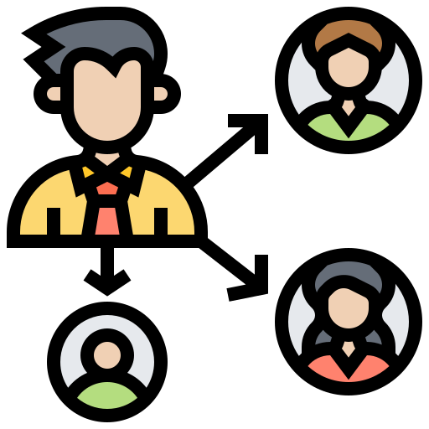

Acquisition could be a Business Nightmare
Users cannot access
Allow Access
IT workers cannot fix problem
Delegate
Governance is gone
Segregate
Is there any IT solution?
multidomain

Slide 8

Allow Access…
Massive Dynamic
Globex
…with Domain Broker

Slide 9

Allow Access…
Massive Dynamic
Acme Corporation
…with Domain Broker

Slide 10


Allow Access…
Acme Corporation
…with Domain Broker

Slide 11

Delegate Assets Management
Integrate IT departments easily, empower delegation

Slide 12



Segregate users' roles, privileges and profile
Simple User
jdoe@acme.org
ACM0C275D
Sales Affiliate
j.doe2@md.org
MD096547
Sales Manager
j.doe@glx.org
00104GLX

Slide 13
Other multidomain usage cases
One domain for one scope:
Internal user – B2E
External user – B2C
Business user – B2B
Logical segregation of business unit:
Delegate and separate company in silos (SOD principles)
B2B^{2B} scenario:
Resell branded managed IAM services

Slide 14

What is multidomain feature?
Multidomain idea was globally recognized:
multidomain feature
obtained a patent in 2019

Slide 15
Thank you for your attention

Slide 16
MultiDomain: govern DIGITAL IDENTITY ASSETS through different domains
Enrico Fabris
Chief Technology Officer
12/04/2024

Slide 17

What is a domain?
Traditional idea of domain:
Fully Qualified Domain Name
Active Directory Domain
Email Domain
A domain is an isolated applicative context
ACME CO.
E CORP

Slide 18

Acquisition could actually be a Business Nightmare
Users cannot access
Allow Access
IT workers cannot fix problem
Delegate
Governance is gone
Segregate
Is there any IT solution?
multidomain

Slide 19
Delegate Assets Management
Integrate IT departments easily: everyone administrates what he knowns

